Slide 1
Capstone Project
EDA Airbnb Bookings Analysis

Slide 2
Content :
1) Introduction.
2) General overview of dataset.
3) Missing value Handling.
4) Univarirate Analysis.
5) Multivariate Analysis.
6) Conclusion.

Slide 3
Introduction.
Since 2008, guests and hosts have used Airbnb to expand on traveling possibilities and present a more unique, personalized way of experiencing the world.
Today, Airbnb became one of a kind service that is used and recognized by the whole world.
Data analysis on millions of listings provided through Airbnb is a crucial factor for the company.
These millions of listings generate a lot of data - data that can be analyzed and used for security, business decisions, understanding of customers' and providers' (hosts) behavior and performance on the platform, guiding marketing initiatives, implementation of innovative additional services and much more.

Slide 4
General overview of dataset.
This dataset has around is mix between categorical and numeric values.
Price is a dependent column.
Total 16 columns are present in the dataset.
Total observations are 48895.
Min of Price variable is 0, max is 10000$.
Mean price is 152$
On an average people stay 7 days in a room.
75 Percentage of times minimun neights stayed is 5.
Mean reviews given to Room/apartment is 23.

Slide 5
Missing value Handling.
‘name’ = 16 null values.
‘host_name’ = 21.
‘last_review’ = 10052.
‘reviews_per_month’ = 10052
‘name’ column we will replaced the ‘nan’ values with corresponding ‘room_type’ values.
‘host_name’ will not use as those are names of individuals.
'reviews_per_month' we will replace with 0 for NA values.
In ‘last_review’ We will convert its data type to catogorical and replace 'NA' with 'never'.

Slide 6
Univariate Analysis.

Slide 7
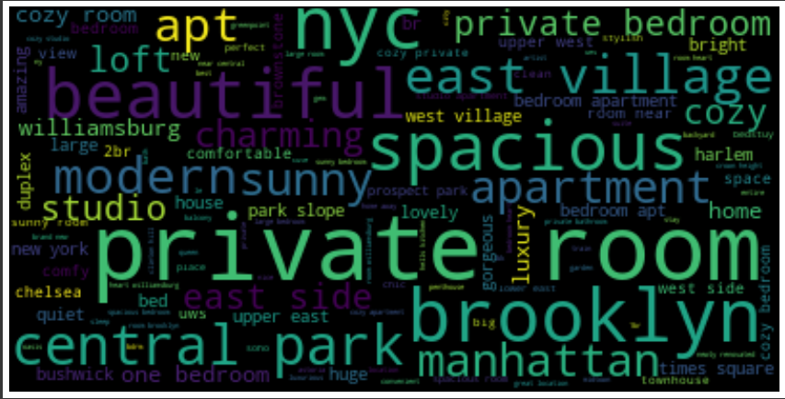
column_no_1:name Word Cloud

Slide 8
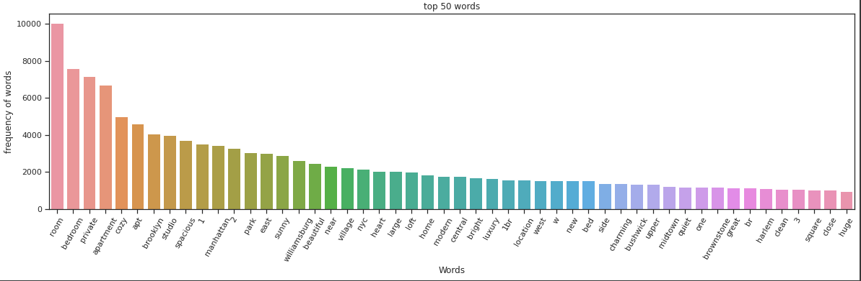
Top 50 words form Word_Cloud:

Slide 9
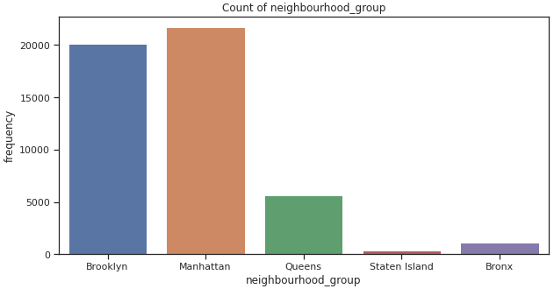
column_no_3 neighbourhood_group

Slide 10
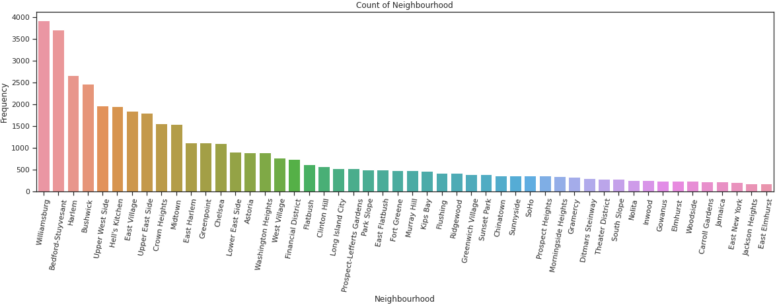
column_no_4 neighbourhood:
top 50 neighbours:
Observations:
People like to stay at these towns more offent.

Slide 11
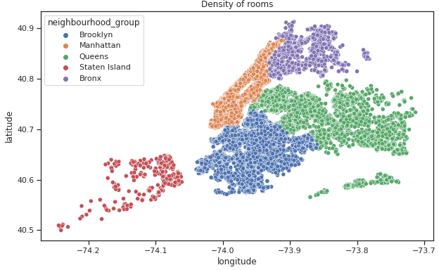
column_no_5 latitude & longitude

Slide 12
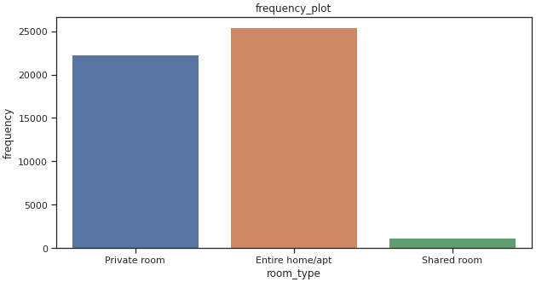
Column_no_6 room_type
Observations:
1.There are three types of rooms
2. Namely:
1.Private room
2.Entire home/apt room_type
3.Shared room.
3.People mostly prefered to take
whole apartment on rent followed by
Private room.
4. very few people prefered to have
shared rooms.
We will try to catogorise the 'price' like cheep,affordable and expensive and then analyse
the 'price' for 'room_type' as per it.

Slide 13
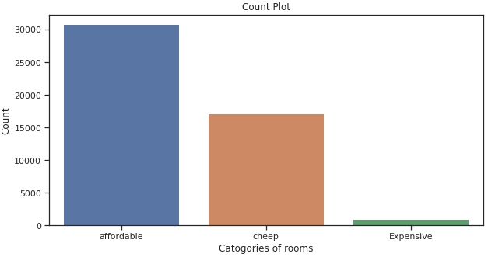
column_no_7 price
cheep (price range below or equal to 80$)
Affordable(for price range 80 to 500$)
Expensive(for price range more then 500$) so, it look like people have more intrest in having "affordable" rooms/apartments rathre then having cheep and expensive rooms.

Slide 14
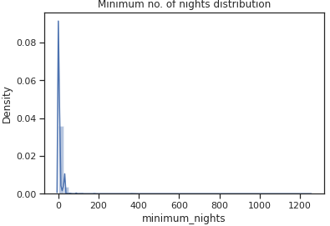
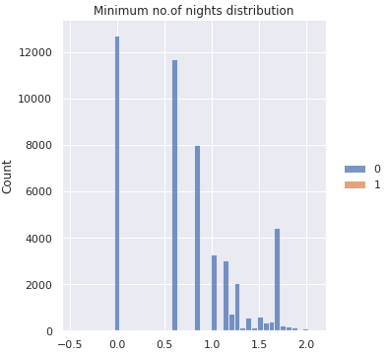
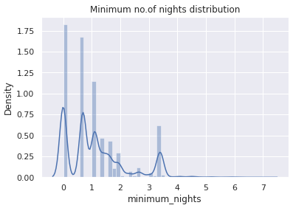
column_no_8 minimum_nights
Distribution Plot without
transformation:
Distribution plot after
Box_Cox transformed:
Distribution plot after
log_transform:
Observations:
we can say that the data is right skwed so, we can do log transformation.
log_transformed plot shows that majority of room booking is one for 1 to 4 days.
we have set the lambda parameter not equal to zero so it by defination of bax-cox transform
selected the best value of lambda.

Slide 15
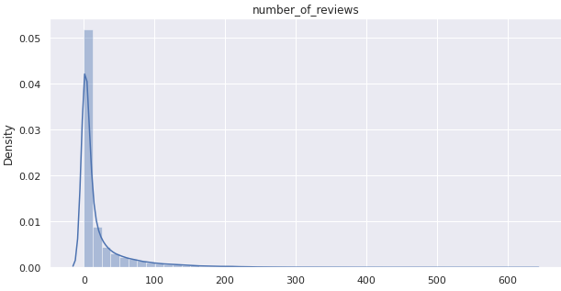
column_no_9 Number_of_reviews
Observatios:
Number of reviews are highly dense form 0 to 100 reviews.
we can say that most of the rooms are not rated and those which are frequently occupied only those are rated.
maximun 629 times the perticular room is rated.
Average rating is around 23.

Slide 16
column_no_9 calculated_host_listings_count
Most_common 50 host_listing_count
There is one host who is 327 time listed.
This is the corresponding host_id 219517861 who is having highest listing.
This is the corresponding host_id 15400695 who is having lowest listing.
column_no_10 last_review
max is 58 times the rating is given.
min is 0.
75% of data is for 1.5 time rating.

Slide 17
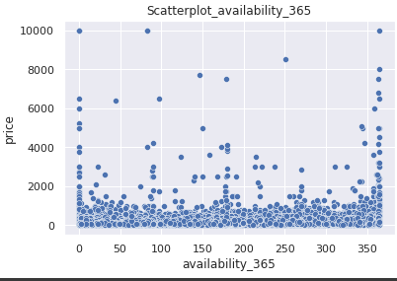
column_no_11 availability_365
Observations:
1. From above plot we can see that most of the available rooms are in the proce range of 0 to 2000.
2. Very few are available for price above 2000$,this is quite obivious that there are very few peoples
who prefer to have expensive rooms.

Slide 18
Multivariate Analysis:

Slide 19
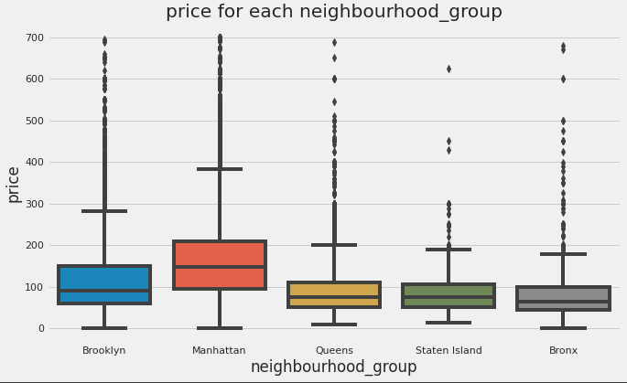
Lets find the relation between neighbourhood_group
and price:

Slide 20
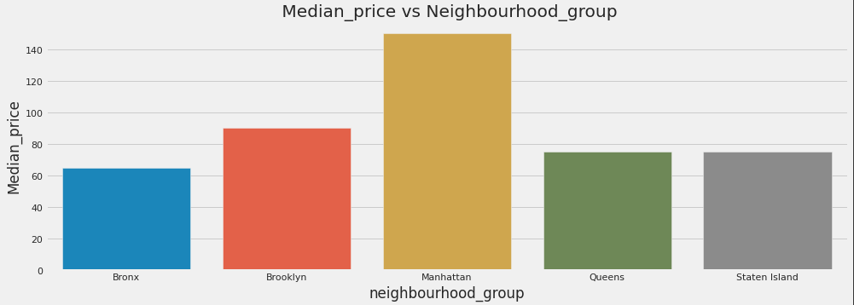
Relationship between neighbourhood_group and median price.

Slide 21
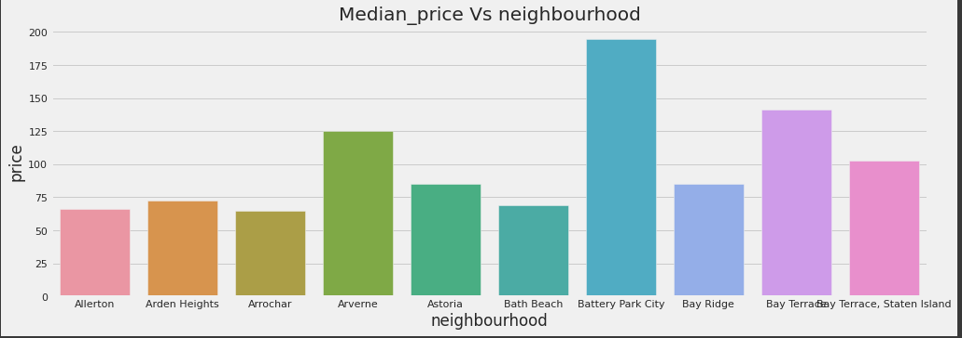
Relation between neighbourhood and price:

Slide 22
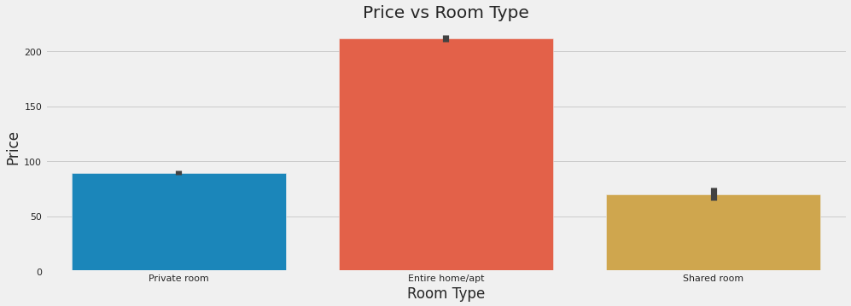
Relationship between price and room_type

Slide 23
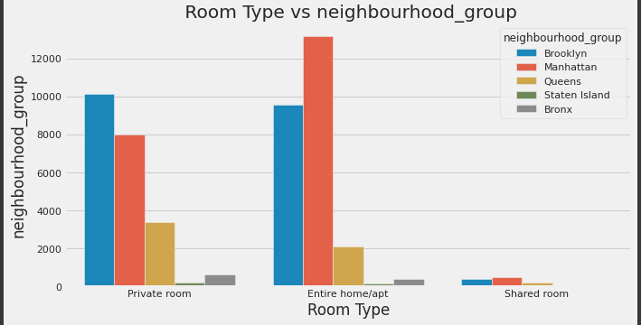
Relationship between room_type and neighbourhood_group.

Slide 24
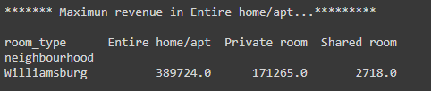
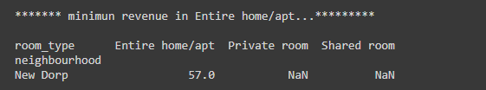
Which neighbourhood are generating maximum,minimum,reveneus from room types.

Slide 25
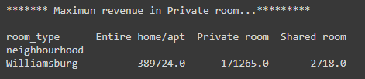
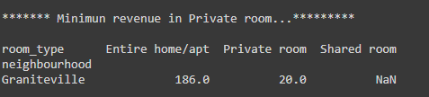

Slide 26
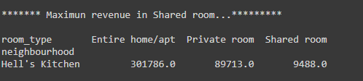
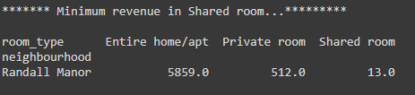

Slide 27
Conclusion:
We tried to put some light by performed the Extensive EDA for Airbnb
dataset as allways there is no end toEDA this can be extended in
n-dimenssions and lots and lots of conclusion can be drawn from EDA
this is where 80% of time is been spent by and Data Scientist.
Thankyou

